Slide 1


Book Now
Developers:
Yousef Masarwi | 208940320
Nael Abu Raya | 211640925
Ibrahim Horani | 316203405
Muhammed Khateb | 212187256

Slide 2



What Is BookNow
Description:
BookNow is an Android application designed to facilitate booking and managing appointments for both businesses and customers. It provides customers with a platform to discover featured businesses, browse services, view available time slots, and book appointments hassle-free. On the other hand, it empowers businesses to showcase their services, manage their schedules, and efficiently handle customer appointments.
Goals:
Customer Convenience
Business Management
Streamlined Communication

Slide 3
Problem Space & Analysis
Customers’ Problem :
Complex Appointment Scheduling: Traditional methods of appointment scheduling involve phone calls, emails, or in-person visits, which can be inefficient and prone to errors.
Business Owners Problem :
Businesses often rely on manual methods to manage appointments, leading to inefficiencies, double bookings, and missed appointments.
Analysis & Solution:
No doubt BookNow represents a conceptual solution for the two essential problems mentioned above, How? BookNow provides efficient appointments scheduling and management for both customers and business owners, respectively.

Slide 4

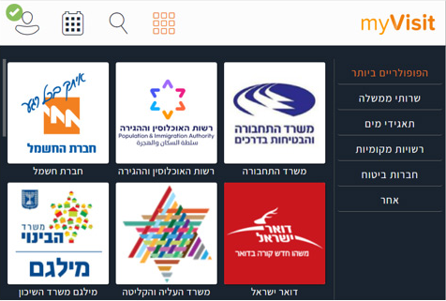
Similar Systems
myVisit

Slide 5

BookNow VS myVisit
Specializes in local businesses.
Can be extended to be governmentally or globally.
Better user interface.
Specializes in governmental institutions.
Meant to be used in Israel.
Weak user interface.

Slide 6
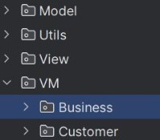


System Structure & Divisions

Slide 7
Roles Division
Muhammed & Nael:
Developing the customers side.
Back-End
Front-End
Yousef & Ibrahim:
Developing the business side.
Back-End
Front-End

Slide 8
Requirements
Non Functional | Functional
User-Friendly Interface | Signing In / Up
Consecutive Services (Usability) | Dashboard Pages
Reusable Components | Booking/Editing/Cancelling Appointments
 | Viewing Bookings History

Slide 9
Features
1
2
3
Customer & Business Dashboards
Category Filtering & Browsing
Featured Businesses
4
5
6
Working Hours
Booking Appointments
Managing Appointments

Slide 10
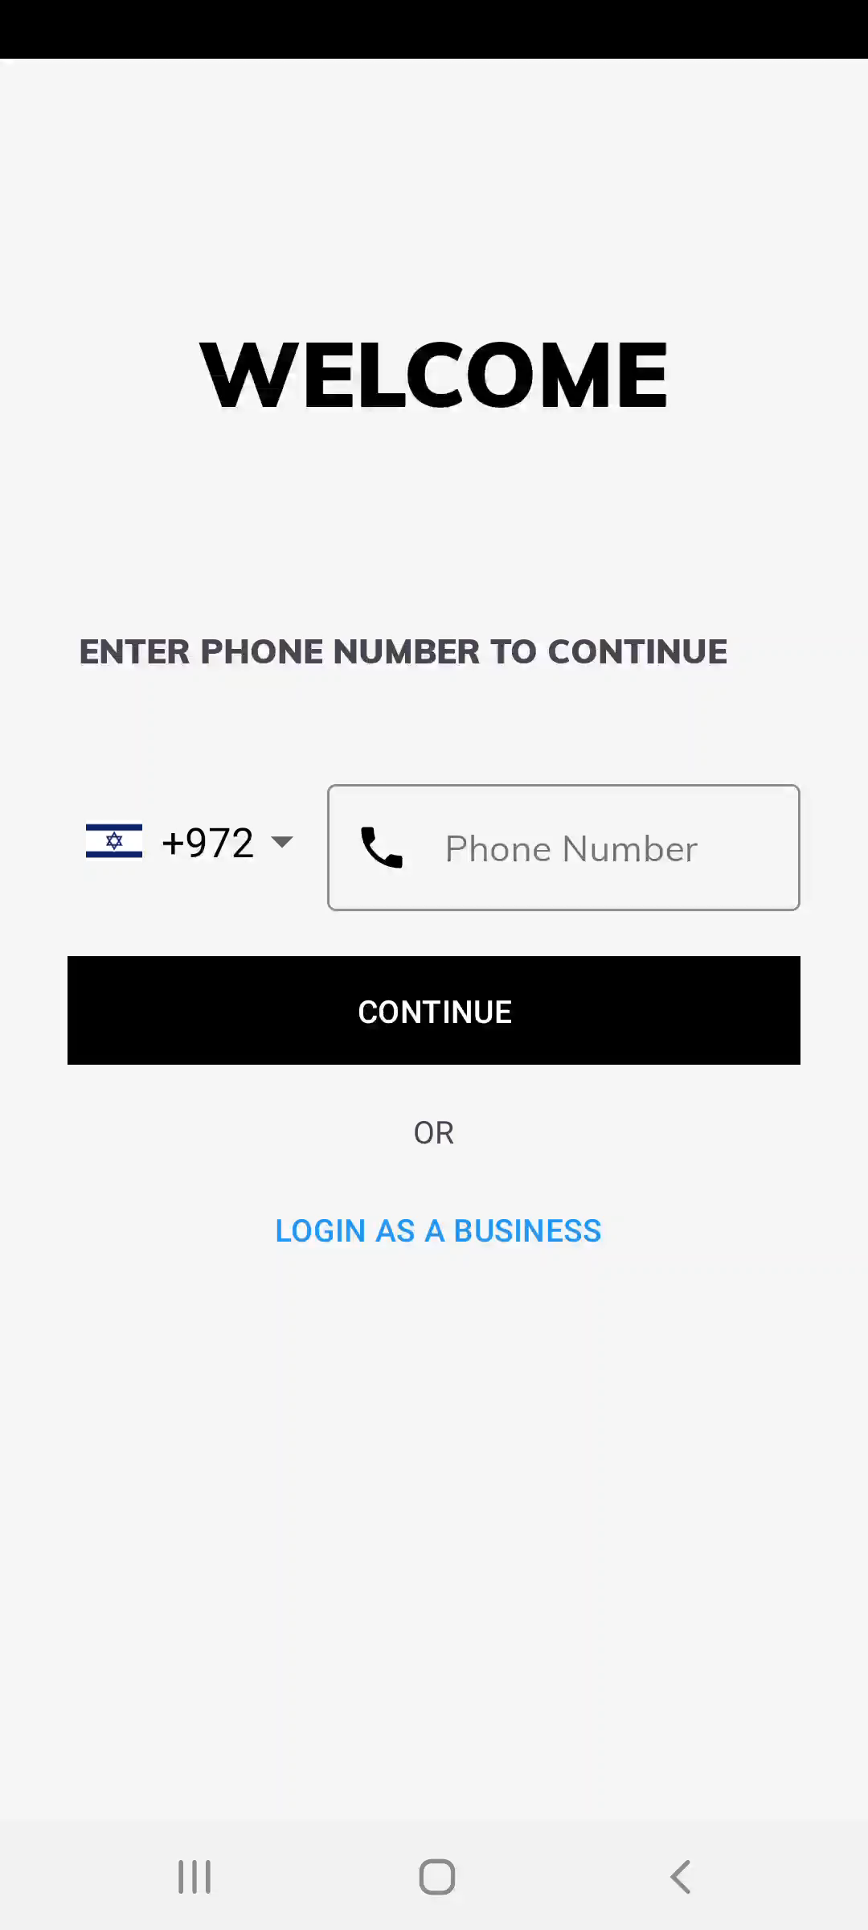

Customers Perspective

Slide 11

Business Owners Perspective

Slide 12
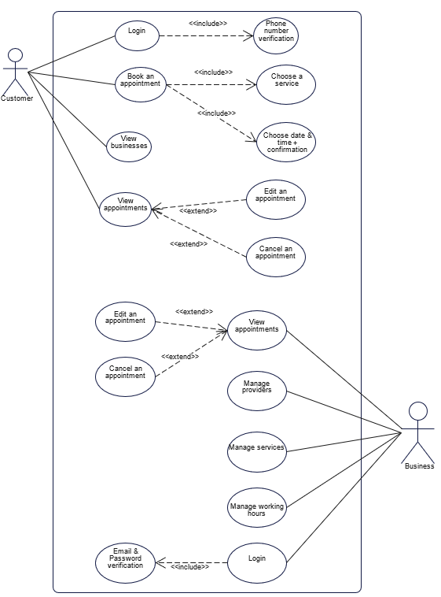

Use Case Diagram

Slide 13
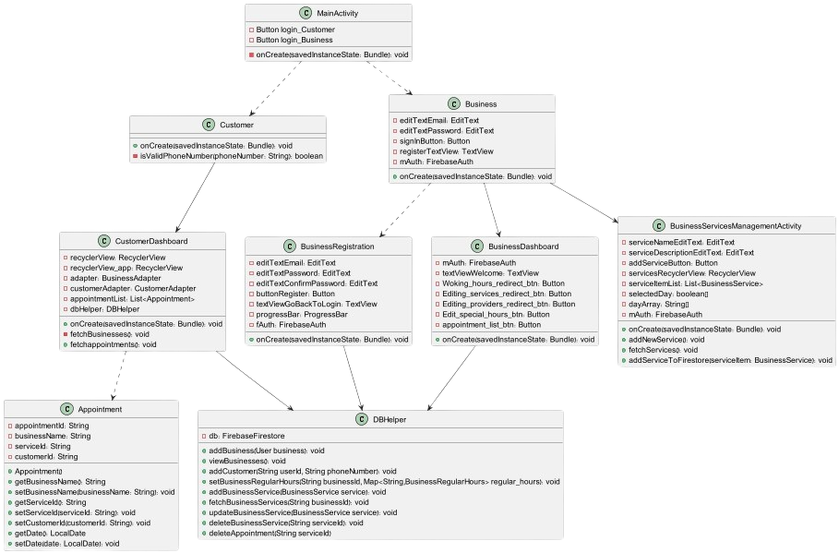
Class Diagram

Slide 14






Gaps To Fill
Lack of time?
Performing Transactions
Confirming Customers Arrival To The Appointments
Notifying Customers Before Reaching Their Appointments

Slide 15


